Slide 1

King ABDUL AZIZ University
Faculty Of Computing and Information Technology
CS 454
Computer graphics
Two Dimensional Viewing
Dr. Eng. Farag Elnagahy
farahelnagahy@hotmail.com
Office Phone: 67967

Slide 2
The Viewing Pipelined
In the previous chapters we described: several graphics algorithms for lines and circles that generated the image using coordinate system of the display screen; the x and y coordinates are integers with values within the horizontal and vertical screen boundaries.
For many applications this coordinate system is too restrictive.

Slide 3
The Viewing Pipelined
As an example:
Assume a map designer using a computer-aided design(CAD) system wants to draw a map for any country.
The best coordinate system might be one with the origin in the middle of the map and coordinate values ranging from –1000 to 1000 in both the horizontal and vertical directions.
Furthermore, while drawing some parts of the map, the designer may want to work with an enlarged display of those parts.

Slide 4
The Viewing Pipelined
A world-coordinate area selected for display is called a window (defines what is to be viewed).
An area on a display device to which a window is mapped is called a viewport (defines where it is to be displayed).
Often, windows and viewports are rectangles in standard position, with the rectangle edges parallel to the coordinate axes.
Other window or viewport geometries, such as general polygon shapes and circles, are used in some applications, but these shapes take longer to process.

Slide 5
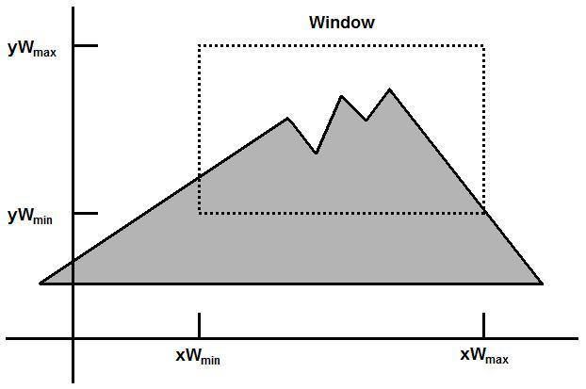
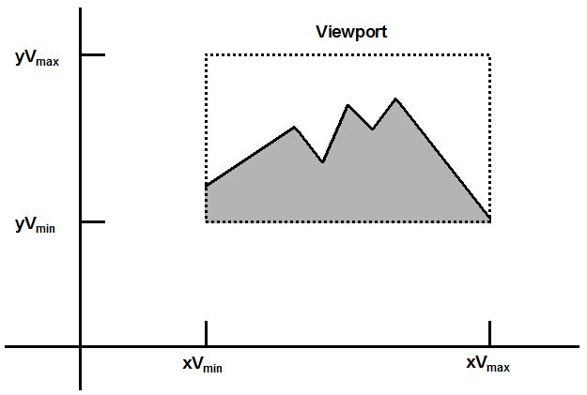
The Viewing Pipelined
The mapping of a part of a world-coordinate scene to device coordinates is referred to as a viewing transformation.
2D viewing transformation is simply referred to as the window-to-viewport transformation or the windowing transformation.

Slide 6
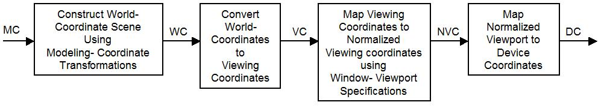
The Viewing Pipelined
The viewing transformation is carry out in several steps, as shown in the figure.
Construct the scene in world coordinate (WC) using the output primitives such as line and circle and their attributes.
Obtain a particular orientation for the window, set up a two-dimensional viewing coordinate (VC) system in the world coordinate plane, and define a window in the viewing coordinate system.

Slide 7
The Viewing Pipelined
The viewing – coordinate reference frame is used to provide a method for setting up arbitrary orientations for rectangular windows. Once the viewing reference frame is established, we can transform descriptions in world coordinates (WC) to viewing coordinates (VC).
We then define a viewport in normalized coordinates (NVC) (in the range from 0 to 1) and map the viewing – coordinate description of the scene to normalized– coordinate.

Slide 8
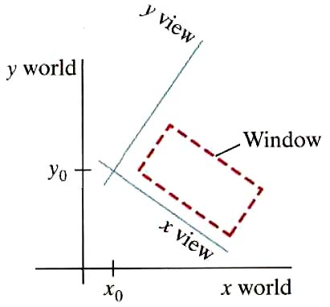
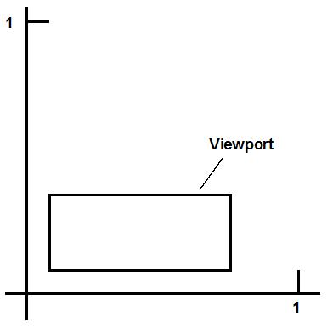
The Viewing Pipelined
At the final step, all parts of the picture that lie outside the viewport are clipped, and the contents of the viewport are transferred to device coordinates (DC).
A rotated viewing-coordinate reference frame and the mapping to normalized coordinates.

Slide 9
The Viewing Pipelined
By changing the position of the window, we can view objects at different positions on the display area of an output device.
By varying the size of viewports, we can change the size and proportions of the displayed objects. We achieve zooming effects by successively mapping different-sized windows on a fixed-size viewport.
As the windows are made smaller, we zoom in on some part of a scene to view details that are not shown with larger windows.

Slide 10
The Viewing Pipelined
Similarly, more overview is obtained by zooming out from a section of a scene with successively larger windows.
Panning effects are produced by moving a fixed-size window across the various objects in a scene.

Slide 11
The Viewing Pipelined
Viewports are typically defined within the unit square (normalized coordinates). This provides a means for separating the viewing and other transformations from specific output-device requirements, so that the graphics package is largely device-independent.
Once the scene has been transferred to normalized coordinates, the unit square is simply mapped to the display area for the particular output device in use at that time. Different output devices can be used by providing the appreciate device derivers.

Slide 12
The Viewing Pipelined
Viewing Coordinate Reference Frame
To obtain the matrix for converting world-coordinate positions to viewing coordinates:
First, we translate the viewing origin to the world origin.
Second, we rotate the two coordinate reference frames.
M_{wc, vc} = R.T
Where T is the translation matrix and R is the rotation matrix

Slide 13
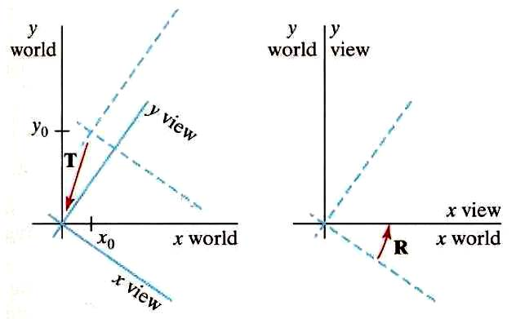
The Viewing Pipelined
 |  | 1 | 0 | –x₀
T(–x₀, –y₀) = |  | 0 | 1 | –y₀
 |  | 0 | 0 | 1
 |  | cos θ | sin θ | 0
R(–θ) = |  | – sin θ | cos θ | 0
 |  | 0 | 0 | 1
Where θ is the orientation angle between the xworld and xview axes.

Slide 14
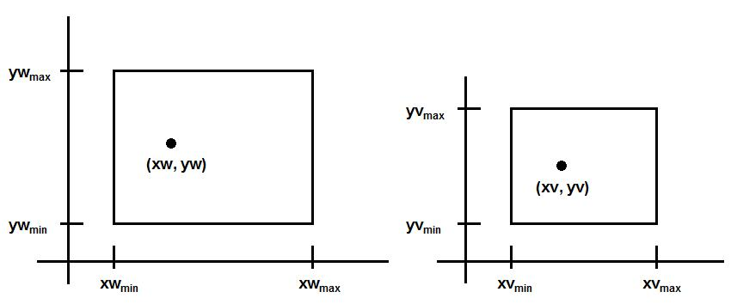
The Viewing Pipelined
Window to Viewport Coordinate Transformation
 | xv – xv_{min} | = | xw – xw_{min}
 | xv_{max} – xv_{min} |  | xw_{max} – xw_{min}
 | yv – yv_{min} | = | yw – yw_{min}
 | yv_{max} – yv_{min} |  | yw_{max} – yw_{min}

Slide 15
The Viewing Pipelined
Window to Viewport Coordinate Transformation
Solving these expressions for the viewport position (xv, yv), we have
xv = xv_{min} + (xw – xw_{min})s_{x}
yv = yv_{min} + (yw – yw_{min})s_{y} Equation 1
where the scaling factors are
s_{x} = xv_{max} – xv_{min} / xw_{max} – xw_{min}
s_{y} = yv_{max} – yv_{min} / yw_{max} – yw_{min}

Slide 16
The Viewing Pipelined
Window to Viewport Coordinate Transformation
Equation 1 can also be derived with a set of transformations that coverts the window area into the viewport area:
Perform a scaling using a fixed-point position of (xw_{min}, yw_{min}) that scales the window area to the size of the viewport.
Translate the scaled window area to the position of the viewport.

Slide 17
The Viewing Pipelined
Window to Viewport Coordinate Transformation
Relative proportions of the objects are maintained if the scaling factors are the same (s_{x} = s_{y}).
Otherwise world objects will be stretched or contracted in either the x or y direction when displayed on the output device.

Slide 18
Clipping Operations
Clipping Algorithm: Identifies those portions of a picture that are either inside or outside of a specified region of space.
Clip Window: The region against which an object is to be clipped.
  Point Clipping
  Line Clipping (straight-line segments)
  Area Clipping (polygons)
  Text Clipping

Slide 19
Point Clipping
Clip window: rectangle, edges of the clip window (xw_{min}, xw_{max}, yw_{min}, yw_{max})
If xw_{min} ≤ x ≤ xw_{max}
yw_{min} ≤ y ≤ yw_{max}
Then
The point p = (x, y) is saved
for display
Otherwise: the point is clipped (not saved for display).

Slide 20
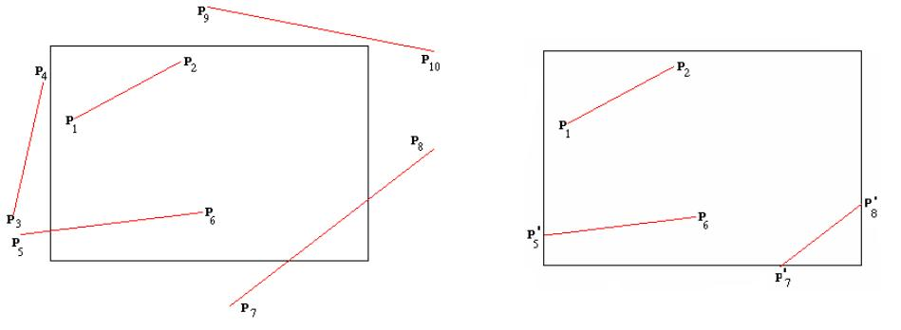
Line Clipping
Line clipping against a rectangular window
before clipping after clipping

Slide 21
Line Clipping
inside – outside test:
Completely Inside: A line with both endpoints inside all clipping boundaries, such as the line from p₁ to p₂, is saved.
Completely Outside: A line with both endpoints outside any one of the clip boundaries, such as the line from p₃ to p₄, is not saved.
If the line is not completely inside or completely outside, we must perform intersection calculations with one or more clipping boundaries.

Slide 22
Line Clipping
A line segment with endpoints (x₁, y₁) and (x₂, y₂) and one or both endpoints outside the clipping rectangle, the parametric representation
x = x₁ + u ( x₂ – x₁)
y = y₁ + u ( y₂ – y₁), 0 ≤ u ≤ 1
If the value of u for an intersection with a rectangle boundary edge is outside the range 0 to 1, the line does not intersect with that boundary.
If the value of u is within the range from 0 to 1, the line segment intersect with that boundary.

Slide 23
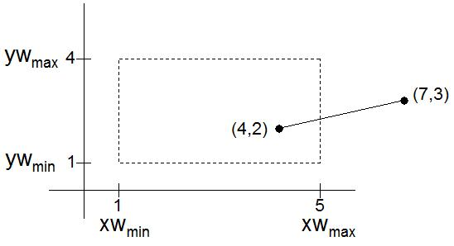
Line Clipping (Example)
Solve u by substitute x = xw_{max} in
x = x₁ + u (x₂ – x₁)
5 = 4 + u (7 – 4)
u = 1/3
The value of u is within the range from 0 to 1, the line segment intersects with the boundary xw_{max}
Solve y by substitute u in y = y₁ + u ( y₂ – y₁)
y = 2 + 1/3 (3 – 2) = 2.33
Intersection point at xw_{max} is (5, 2.33)

Slide 24
Cohen-Sutherland Line Clipping
This method speeds up the processing of the line segment by performing initial tests that reduce the number of intersections that must be calculated.
Every line endpoint in a picture is assigned a four-digit binary code, called region code that identifies the location of the point relative to the boundaries of the clipping rectangle.
Bit 4 | Bit 3 | Bit 2 | Bit 1
Above | Below | Right | Left

Slide 25
Cohen-Sutherland Line Clipping
1001 | 1000 | 1010
0001 | Window 0000 | 0010
0101 | 0100 | 0110
Bit 4 | Bit 3 | Bit 2 | Bit 1
Above | Below | Right | Left

Slide 26
Cohen-Sutherland Line Clipping
Region-code bit values can be determined as follows:
Bit 1 is the sign bit of x – xwmin
Bit 2 is the sign bit of xwmax – x
Bit 3 is the sign bit of y – ywmin
Bit 4 is the sign bit of ywmax – y
If the sign is negative the bit is set to 1
otherwise is set to 0.

Slide 27
Cohen-Sutherland Line Clipping
Any lines that has a region code of 0000 for both endpoint are completely inside, we save these lines.
Any lines that have a 1 in the same bit position in the region-codes for each endpoint are completely outside and we reject these lines.
A method that can be used to test lines for total clipping is to perform the logical AND operation with both region codes. If the result is not 0000, the line is completely outside the clipping region.

Slide 28
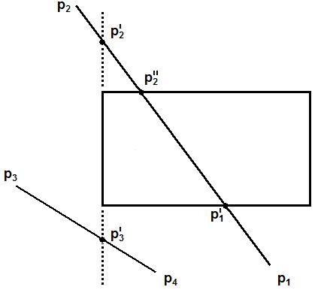
Cohen-Sutherland Line Clipping
p₁ 0100
p₂ 1001
p₃ 0001
p₄ 0100
p₁ AND p₂ =0000
p₃ AND p₄ =0000
Bit 4 | Bit 3 | Bit 2 | Bit 1
Above | Below | Right | Left

Slide 29
Cohen-Sutherland Line Clipping
For a line with endpoint (x₁, y₁) and (x₂, y₂)
m = (y₂ – y₁) / (x₂ – x₁)
Intersection points with the clipping boundary:
The intersection with vertical boundary (x=xw_{min} or x=xw_{max}), the y coordinate can be calculated as:
y = y₁ + m(x – x₁)
The intersection with a horizontal boundary (y=yw_{min} or y=yw_{max.}), the x coordinate can be calculated as
x = x₁ + (y – y₁) / m

Slide 30
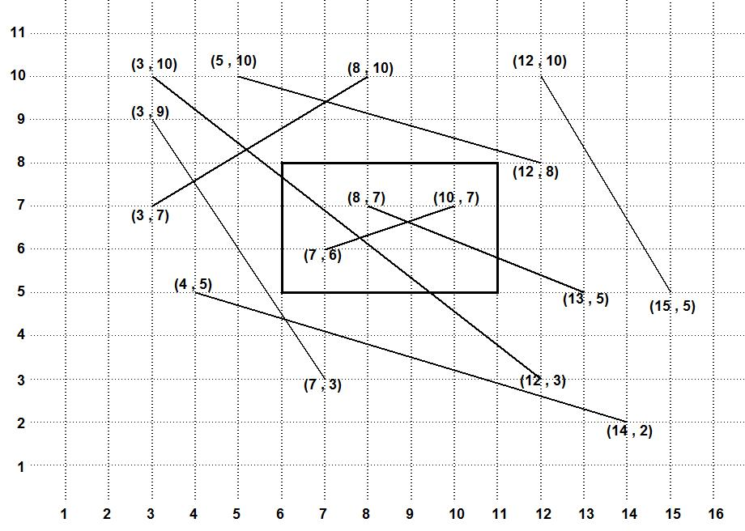
Cohen-Sutherland Line Clipping (Example)

Slide 31
Liang-Barsky Line Clipping Algorithm
For a line segment with endpoints (x₁, y₁) and (x₂, y₂), we can describe the line with parametric form:
x = x₁ + u Δx
y = y₁ + u Δy, 0≤ u ≤1
where Δx= x₂ – x₁ and Δy= y₂– y₁
The point-clipping condition in the parametric form:
xw_{min} ≤ x₁ + u Δx ≤ xw_{max}
yw_{min} ≤ y₁ + u Δy ≤ yw_{max}

Slide 32
Liang-Barsky Line Clipping Algorithm
xw_{min} ≤ x₁ + u Δx ≤ xw_{max}
yw_{min} ≤ y₁ + u Δy ≤ yw_{max}
Each of these four inequalities can be expressed as:
up_{k} ≤ q_{k}, k=1, 2, 3, 4
where the parameters p and q are defined as:
p₁ = – Δx, q₁ = x₁ – xw_{min}
p₂ = Δx, q₂ = xw_{max} – x₁
p₃ = – Δy, q₃ = y₁ – yw_{min}
p₄ = Δy, q₄ = yw_{max} – y₁

Slide 33
Liang-Barsky Line Clipping Algorithm
Any lines that is parallel to one of the clipping boundaries has p_{k}=0 for the value of k corresponding to that boundary where k = 1, 2, 3, 4 correspond to left, right, bottom and top boundaries respectively.
If, for that value of k, we also find q_{k} < 0, then the line is completely outside the boundary and can be eliminated from further consideration.
If q_{k} ≥ 0, then the line is inside the parallel clipping boundary.

Slide 34
Liang-Barsky Line Clipping Algorithm
If p_{k} < 0, the infinite extension of the line proceeds from the outside to the inside of the infinite extension of this clipping boundary.
If p_{k} > 0, the line proceeds from the inside to the outside.
For a nonzero value of p_{k} (p_{k} ≠ 0), we can calculate the value of u that corresponds to the point where the infinitely extended line intersects the extension of boundary k as:
u = q_{k} / p_{k}

Slide 35
Liang-Barsky Line Clipping Algorithm
For each line, we can calculate values for parameters u₁ and u₂ that define that part of the line that lies within the clip rectangle.
The value of u₁ is determined by looking at the rectangle edges for which the line proceeds from outside to the inside (p_{k} < 0).
For these edges, we calculate r_{k} = qk / pk.
The value of u₁ is taken as the largest of the set consisting of 0 and the various values of r.

Slide 36
Liang-Barsky Line Clipping Algorithm
The value of u₂ is determined by examining the boundaries for which the line proceeds from inside to the outside (p_{k} > 0).
A value of r_{k} is calculated for each of these boundaries, and
the value of u₂ is the minimum of the set consisting of 1 and the calculated r values.

Slide 37
Liang-Barsky Line Clipping Algorithm
If u₁ > u₂, the line is completely outside the clip window and it can be discarded.
Otherwise, the endpoints of the clipped line are calculated from the two values of parameter u.

Slide 38
Liang-Barsky Line Clipping Algorithm
The Liang-Barsky Line Clipping Algorithm can be summarized as follows:
For each line, calculate the parameters p, q and r:
p₁ = – Δx, q₁ = x₁ – xw_{min}, r₁ = q₁/ p₁
p₂ = Δx, q₂ = xw_{max} – x₁ , r₂ = q₂/ p₂
p₃ = – Δy, q₃ = y₁ – yw_{min}, r₃ = q₃/ p₃
p₄ = Δy, q₄ = yw_{max} – y₁, r₁ = q₄/ p₄

Slide 39
Liang-Barsky Line Clipping Algorithm
Determine the value of u₁ is by looking at the rectangle edges for which the line proceeds from outside to the inside (p_{k} < 0). The value of u₁ is taken as the largest of the set consisting of 0 and the various values of r.
Determine the value of u₂ by examining the boundaries for which the line proceeds from inside to the outside (p_{k} > 0). A value of r_{k} is calculated for each of these boundaries, and the value of u₂ is the minimum of the set consisting of 1 and the calculated r values.

Slide 40
Liang-Barsky Line Clipping Algorithm
If u₁ > u₂, the line is completely outside the clip window and it can be discarded.
Otherwise, the endpoints of the clipped line are calculated from the two values of parameter u.
If u₂ <1 x= x₁+u₂ Δx, y = y₁ +u₂ Δy
Otherwise x = x₂, y = y₂
If u₁ >0 x= x₁+u₁ Δx, y = y₁ +u₁ dy
Otherwise x = x₁, y = y₁

Slide 41
Liang-Barsky Line Clipping Algorithm (Example)

Slide 42
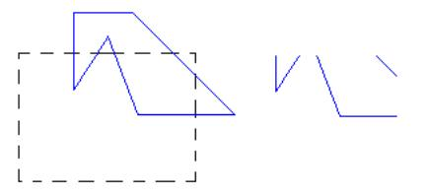
Area Clipping (polygons)
To clip a polygon, we cannot directly apply a line-clipping method to the individual polygon edges because this approach would produce a series of unconnected line segments as shown in figure .

Slide 43
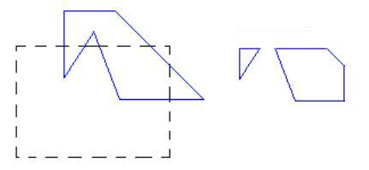
Area Clipping (polygons)
The clipped polygons must be a bounded area after clipping as shown in figure.
For polygon clipping, we require an algorithm that will generate one or more closed areas that are then scan converted for the appreciate area fill.
The output of a polygon clipper should be a sequence of vertices that defines the clipped polygon boundaries.

Slide 44
Sutherland-Hodgman Polygon Clipping
Clip a polygon by processing the polygon boundary as a whole against each window edge.
Processing all polygon vertices against each clip rectangle boundary in turn.
Beginning with the initial set of polygon vertices, we could first clip the polygon against the left rectangle boundary to produce a new sequence of vertices.
The new set of vertices could be successively passed to a right boundary clipper, a bottom boundary clipper, and a top boundary clipper, a right boundary clipper.

Slide 45
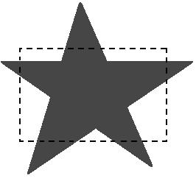
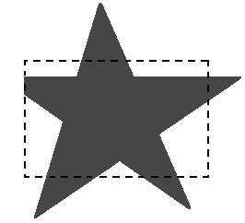
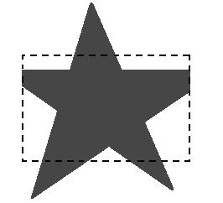
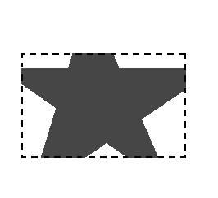
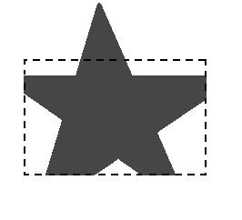
Sutherland-Hodgman Polygon Clipping
Lift Clipper
Right Clipper
At each step, a new sequence of output vertices is generated and passed to the next window boundary clipper.
Bottom Clipper
Top Clipper

Slide 46
Sutherland-Hodgman Polygon Clipping
There are four possible cases when processing vertices in sequence around the perimeter of a polygon.
As each pair of adjacent polygon vertices is passed to a next window boundary clipper, we make the following tests:

Slide 47
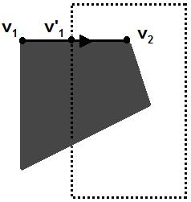
Sutherland-Hodgman Polygon Clipping
If the first vertex is outside the window boundary and the second vertex is inside
Then , both the intersection point of the polygon edge with the window boundary and the second vertex are added to the output vertex list.

Slide 48
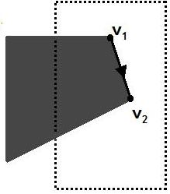
Sutherland-Hodgman Polygon Clipping
If both input vertices are inside the window boundary.
Then, only the second vertex is added to the output vertex list.

Slide 49
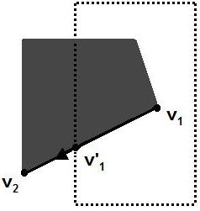
Sutherland-Hodgman Polygon Clipping
If the first vertex is inside the window boundary and the second vertex is outside.
Then, only the edge intersection with the window boundary is added to the output vertex list.

Slide 50
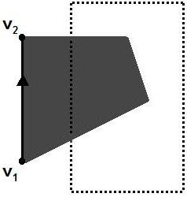
Sutherland-Hodgman Polygon Clipping
If both input vertices are outside the window boundary.
Then, nothing is added to the output vertex list.

Slide 51
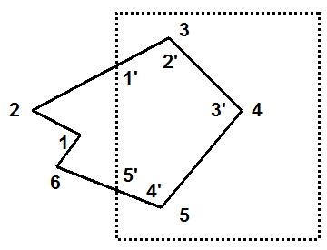
Sutherland-Hodgman Polygon Clipping (Example)
We illustrate this algorithm by processing the area in figure against the left window boundary.
Vertices 1 and 2 are outside of the boundary.
Vertex 3, which is inside, 1' and vertex 3 are saved.
Vertex 4 and 5 are inside, and they also saved.
Vertex 6 is outside, 5' is saved.
Using the five saved points, we would repeat the process for the next window boundary.

Slide 52
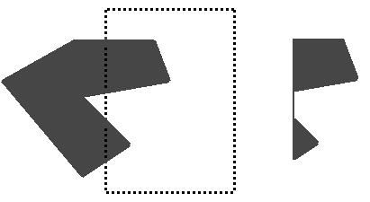
Sutherland-Hodgman Polygon Clipping
The Sutherland-Hodgman algorithm correctly clips convex polygons, but concave polygons may be displayed with extraneous lines as demonstrated in figure.
Since there is only one output vertex list, the last vertex in the list is always joined to the first vertex.

Slide 53
Weiler-Atherton Polygon Clipping
This algorithm was developed for identifying visible surfaces, and can be used to clip a fill area that is either a convex polygon or a concave polygon.
The basic idea of this algorithm is that instead of proceeding around the polygon edges as vertices are processed, we will follow the window boundaries.
The path we follow depends on:
polygon-processing direction (clockwise or counterclockwise)
The pair of polygon vertices
outside-to-inside or an inside-to-outside.

Slide 54
Weiler-Atherton Polygon Clipping
For clockwise processing of polygon vertices, we use the following rules:
For an outside-to-inside pair of vertices, follow polygon boundaries.
For an inside-to-outside pair of vertices, follow window boundaries in a clockwise direction.

Slide 55
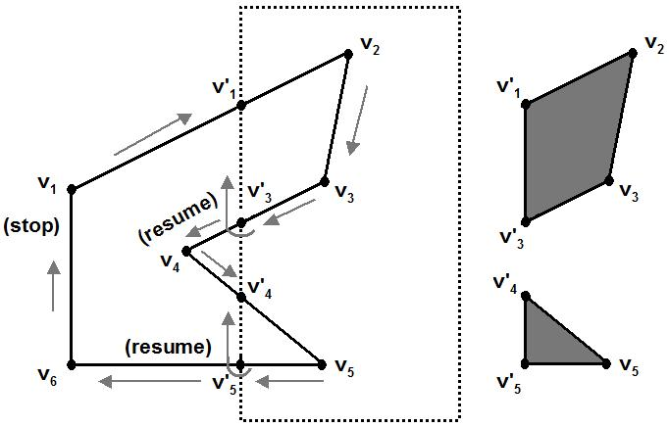
Weiler-Atherton Polygon Clipping (Example)

Slide 56
Text Clipping
There are several techniques that can be used to provide text clipping in a graphics packages.
The choice of clipping method depends on how characters are generated and what requirements we have for displaying character strings.

Slide 57
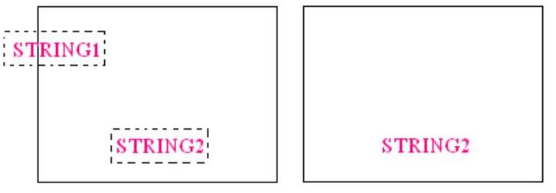
Text Clipping
All-or-none string-clipping
If all of the string is inside a clip window, we keep it.
Otherwise the string is discarded.

Slide 58
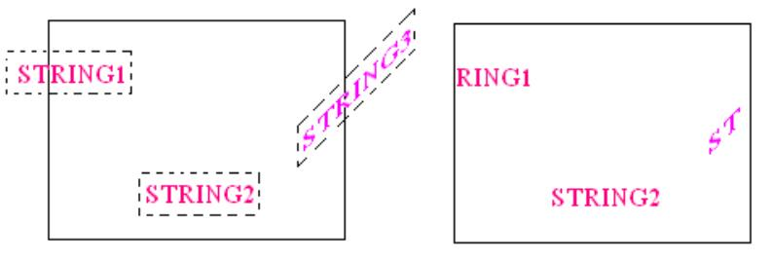
Text Clipping
All-or-none character-clipping
Here we discard only those characters that are not completely inside the window

Slide 59
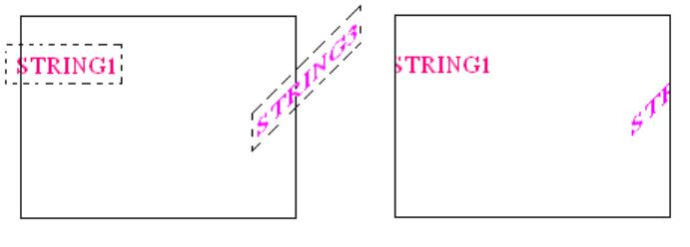
Text Clipping
Clip the components of individual characters
We treat characters in much the same way that we treated lines.
If an individual character overlaps a clip window boundary, we clip off the parts of the character that are outside the window

